Slide 1
2 Meter Copper J-Pole Antenna Build
By:
Gordon Wadey, W3DBX

Slide 2
Antenna Build Project Goals:
Hit the N4POW Repeater
Easy to build
Easy to erect
Durable
Stealthy
Better gain than my ground plane antenna
No radials
Low angle of radiation
Wide bandwidth
Low noise

Slide 3
https://m0ukd.com/calculators/slim-jim-and-j-pole-calculator/

Slide 4
The N4POW Tuned Antenna Jig

Slide 5
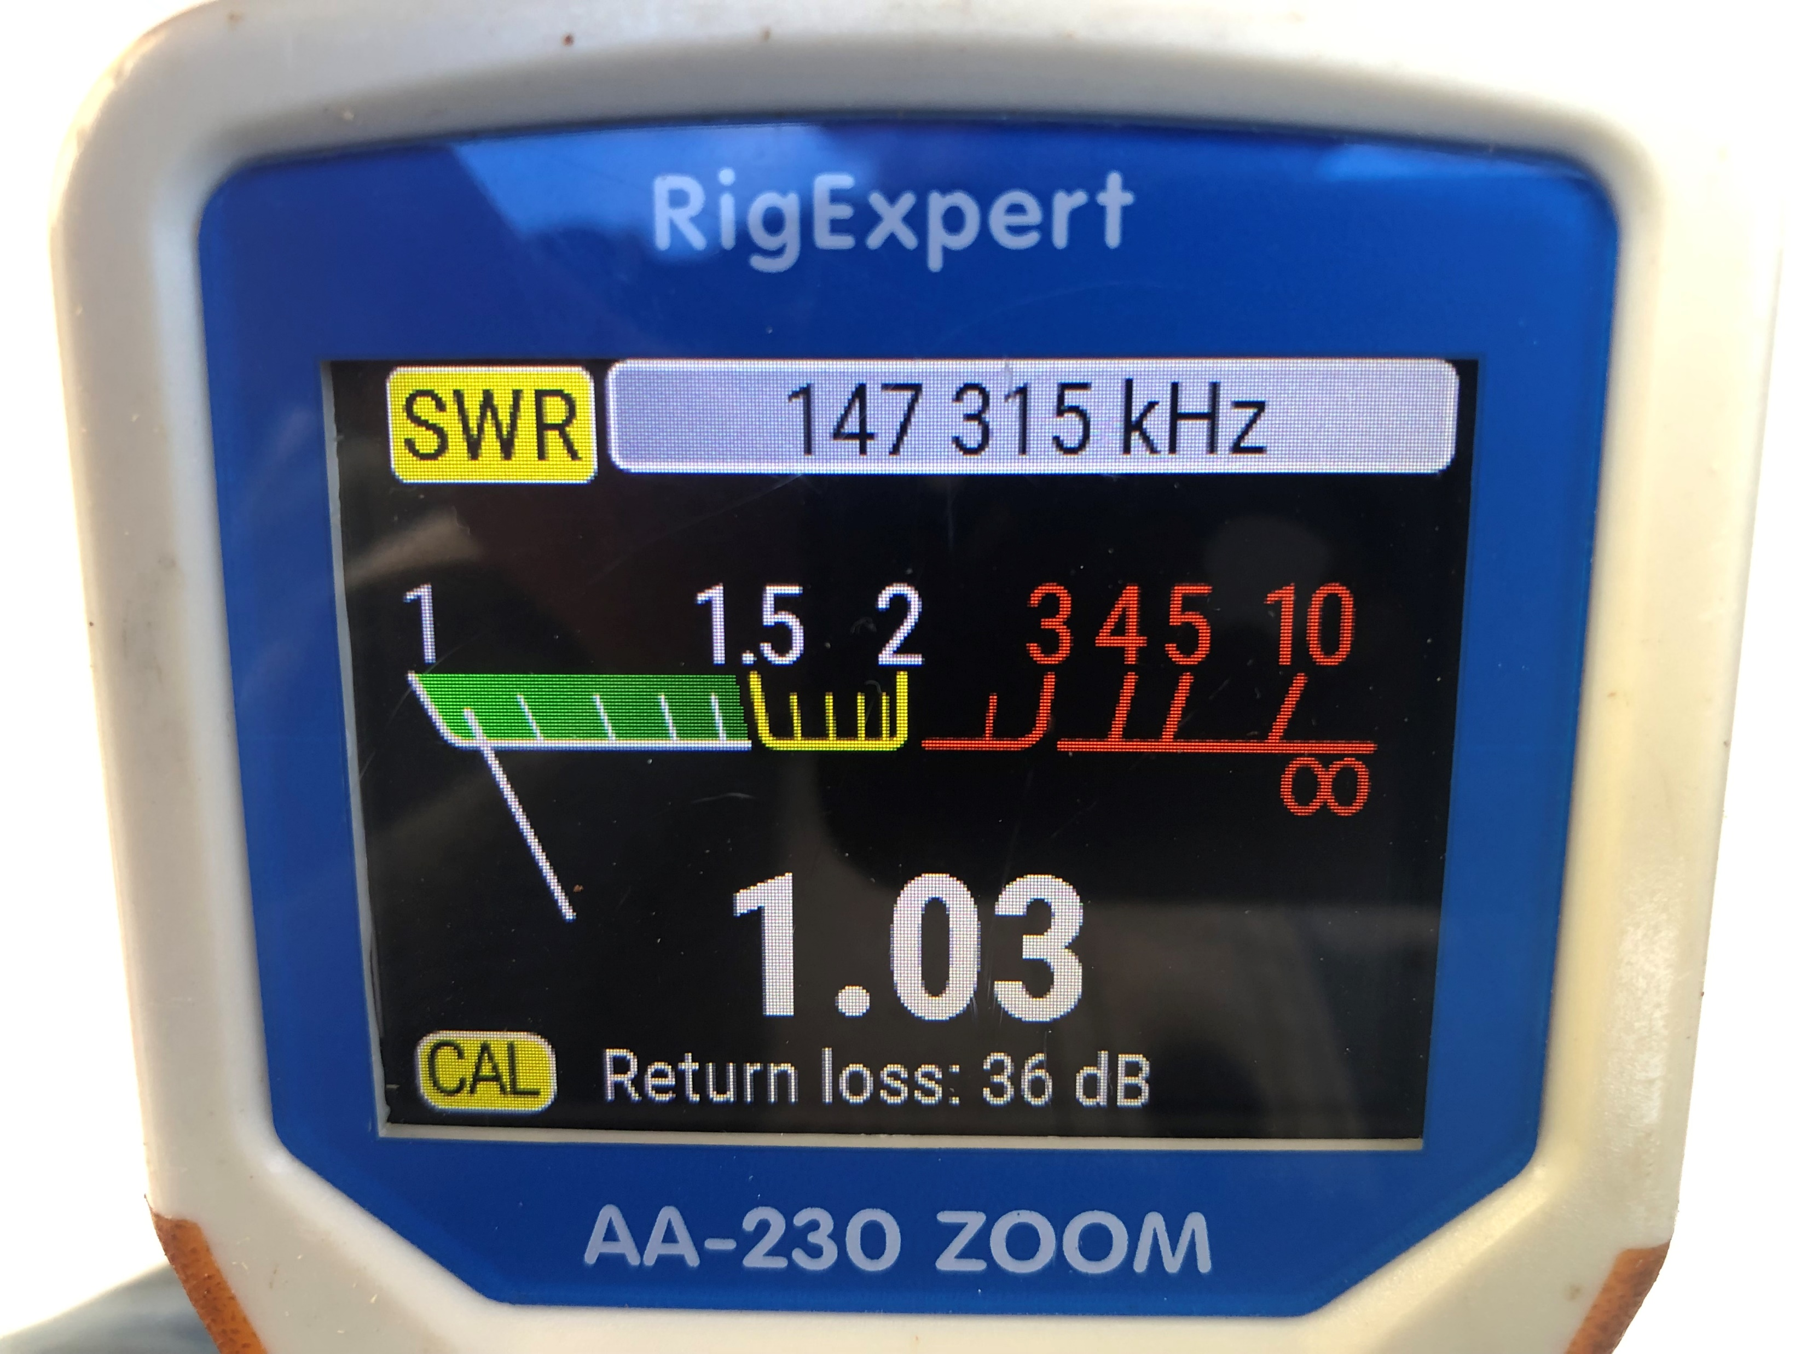
Rig Expert Analyzer results (SWR)

Slide 6
Rig Expert Analyzer results (Bandwidth)

Slide 7
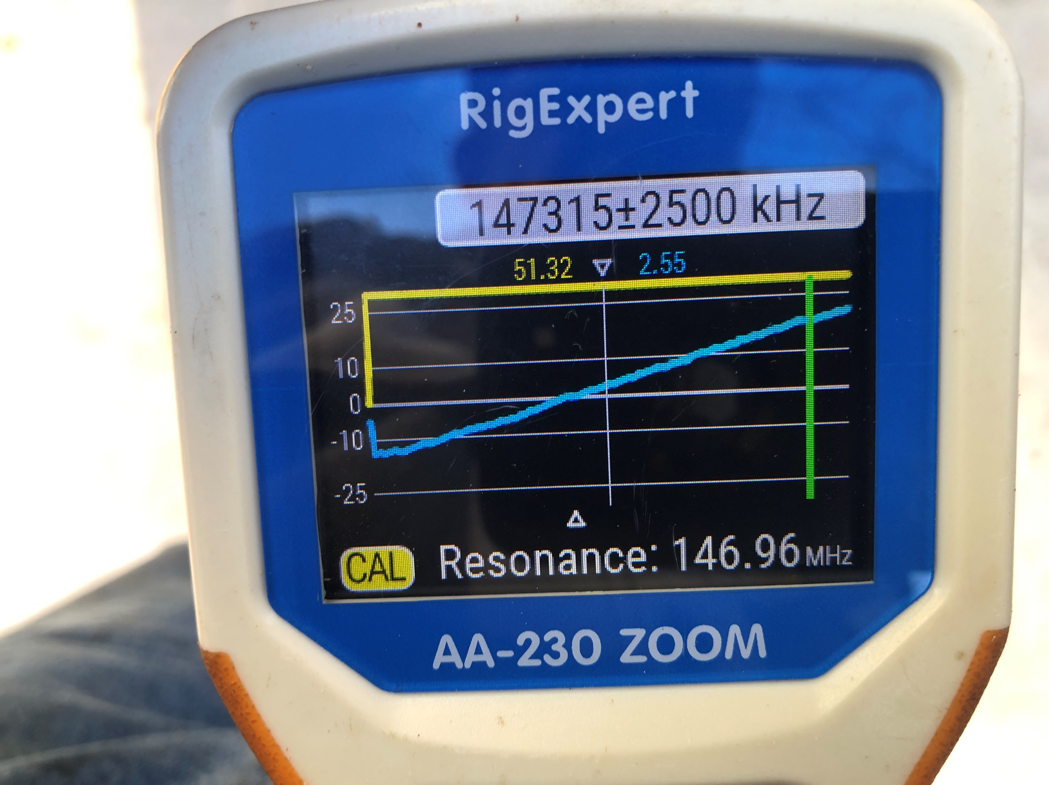
Rig Expert Analyzer results (Resonance)

Slide 8
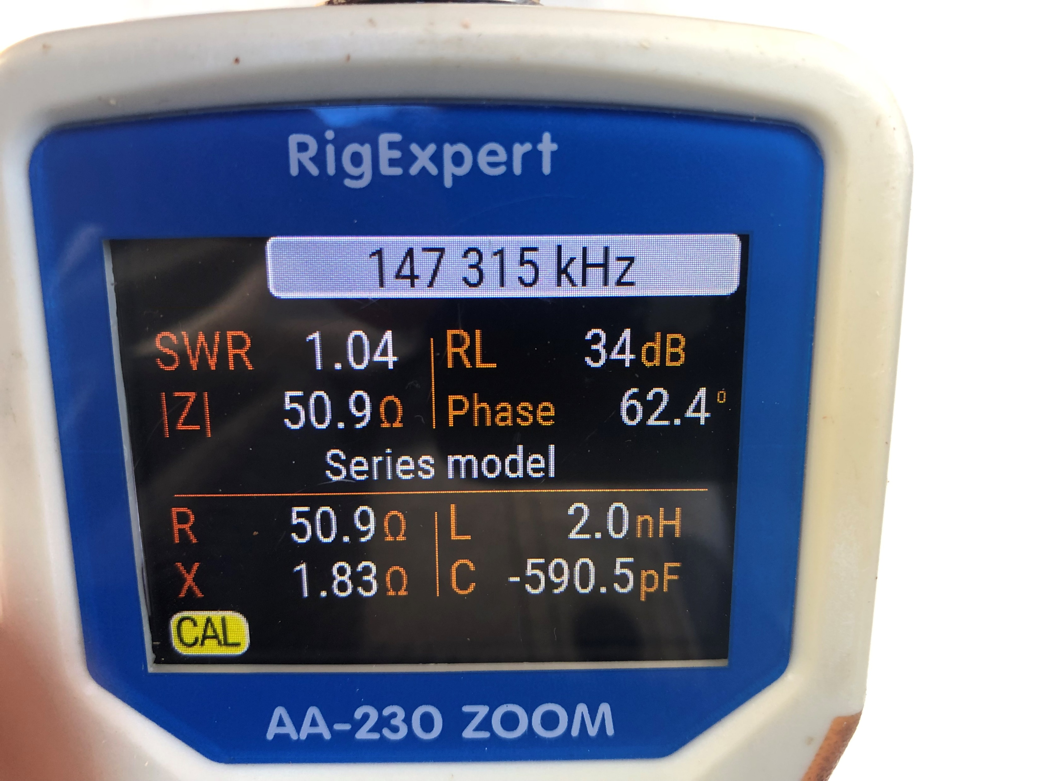
Rig Expert Analyzer results (Parameters)

Slide 9
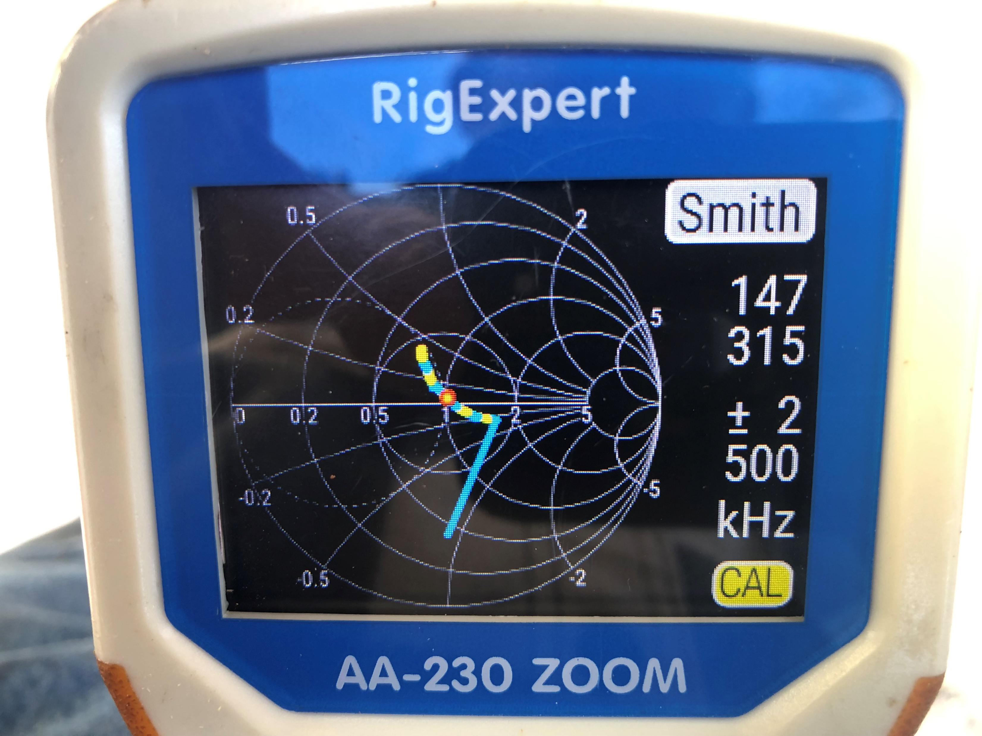
Rig Expert Analyzer results (Smith Chart)

Slide 10
Parts and Tools needed for the build
Copper J-Pole Antenna - Parts List
10’ – ½” Copper Pipe
3 - ½” Caps
1 - ½” Tee
1 - ½” Elbow
1 - ½” Slip Coupling Sleeve – No Stop!
1 - Female Type N Chassis Mount Connector
4” - No. 14 copper wire
Tools / Misc.
Butane Torch
95/5 Plumbing Solder
Tubing cutter
Tape measure
Steel Wool / Sand Paper
Drill & Bit Set
Soldering Iron / Rosin Core Radio Solder

Slide 11
Conclusion
My Project Discoveries:
VHF has unpredictable behavior
Many system factors are in play;
Radio
Connector Type
Coax type
Coax length tuning
Antenna tuning
Vector Network Analyzer (VNA) sequence;
Focus on connectors and coax first
Calibrate VNA
“Null” the coax
Recalibrate VNA with nulled coax
Keep antenna well clear of solid objects
Tune the antenna with “Nulled” coax
Check VNA readings

Slide 12
Thank You!!
Join me for a “hands-on” build of this antenna design on Saturday March 23rd,
at the Fighting Creek Park Pavilion at 9:00AM
Immediately following the 8:00AM PARC Fellowship Breakfast at the County Seat Restaurant
Questions? / Discussion!

