Slide 1
Linked Dipole Antenna
N4POW Monthly Meeting
April 2024
Chuck Nunnelly
N4AVC

Slide 2
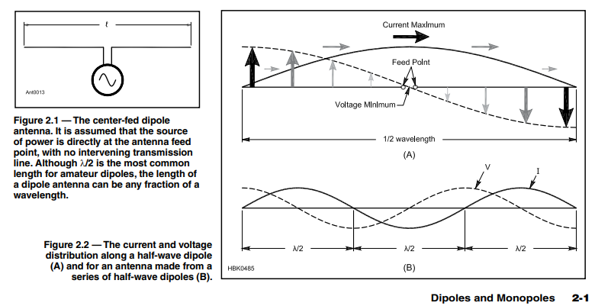
The ARRL Antenna Book, 22nd Edition
(Newington CT, ARRL 2011)

Slide 3
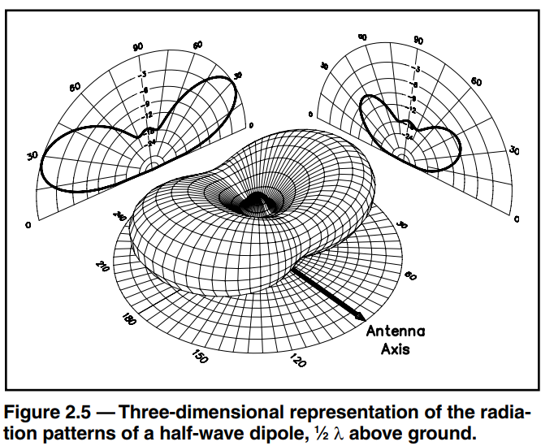
The ARRL Antenna Book, 22nd Edition
(Newington CT, ARRL 2011)

Slide 4
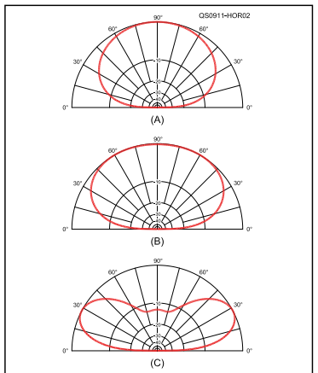
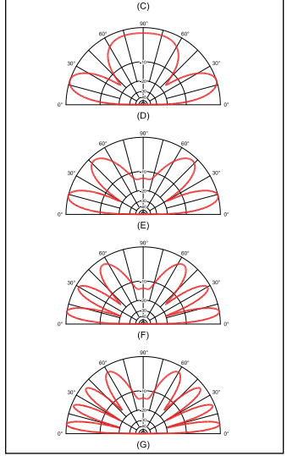
The ARRL Antenna Book, 22nd Edition
(Newington CT, ARRL 2011)

Slide 5
The ARRL Antenna Book, 22nd Edition
(Newington CT, ARRL 2011)

Slide 6
40
20
10
Links
½ wave = 468/freq
Coax Shield
Coax Center
Band | Mid Freq (General) | Dipole ½ Wave (FT) | Dipole ¼ Wave (FT) | Approx. Length Ea ¼ Leg
10 | 29.000 | 16.1 | 8.1 | 8.1
20 | 14.288 | 32.8 | 16.4 | 8.3
40 | 7.238 | 64.7 | 32.3 | 15.9

Slide 7
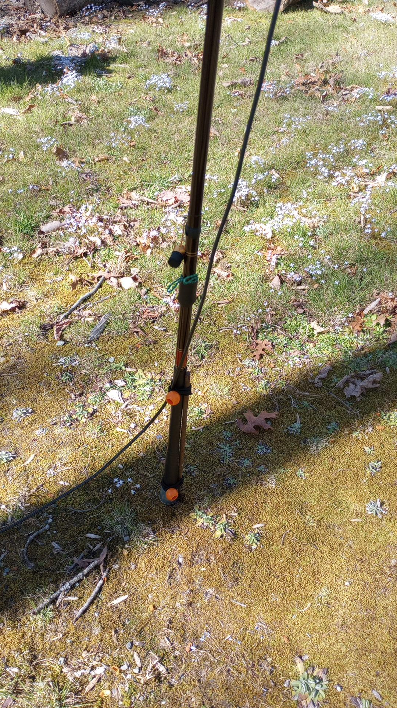
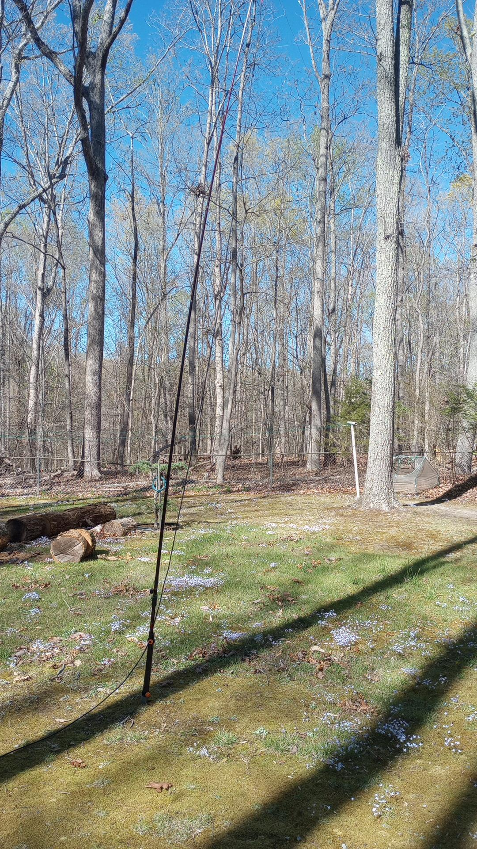
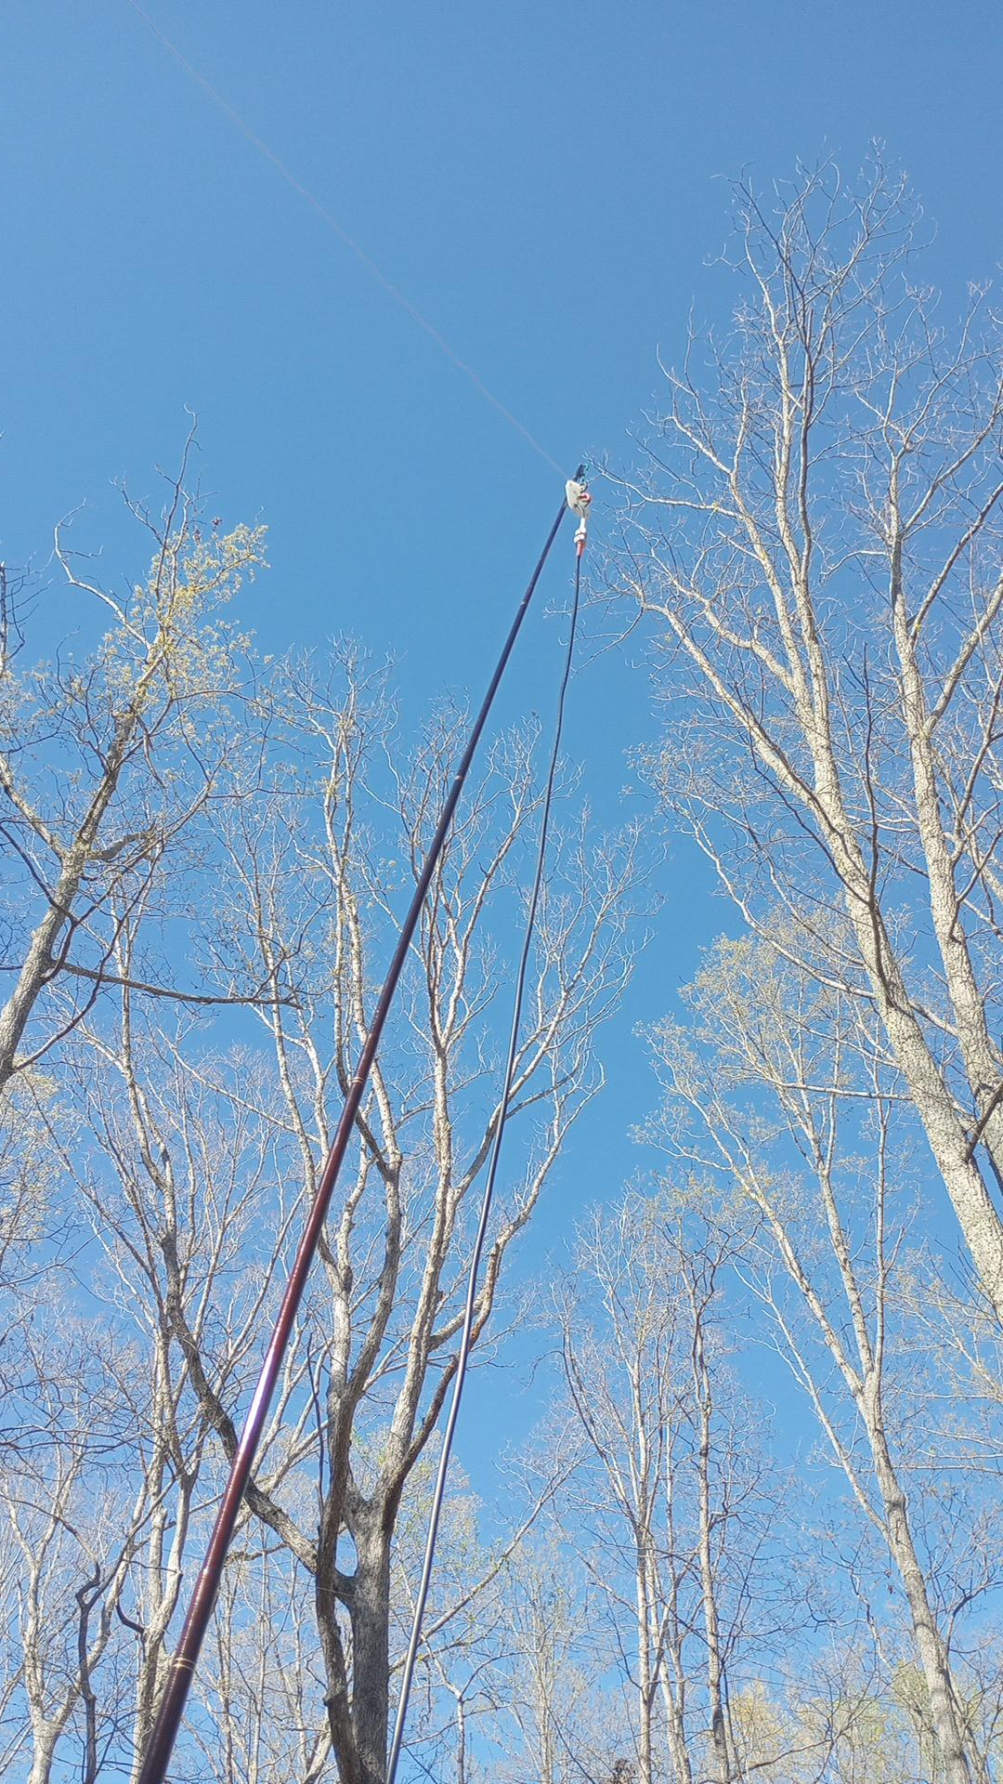

Slide 8
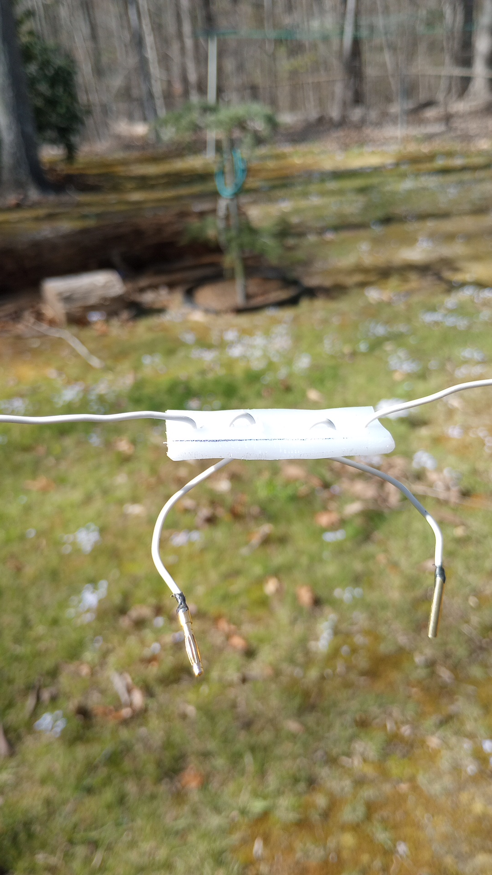
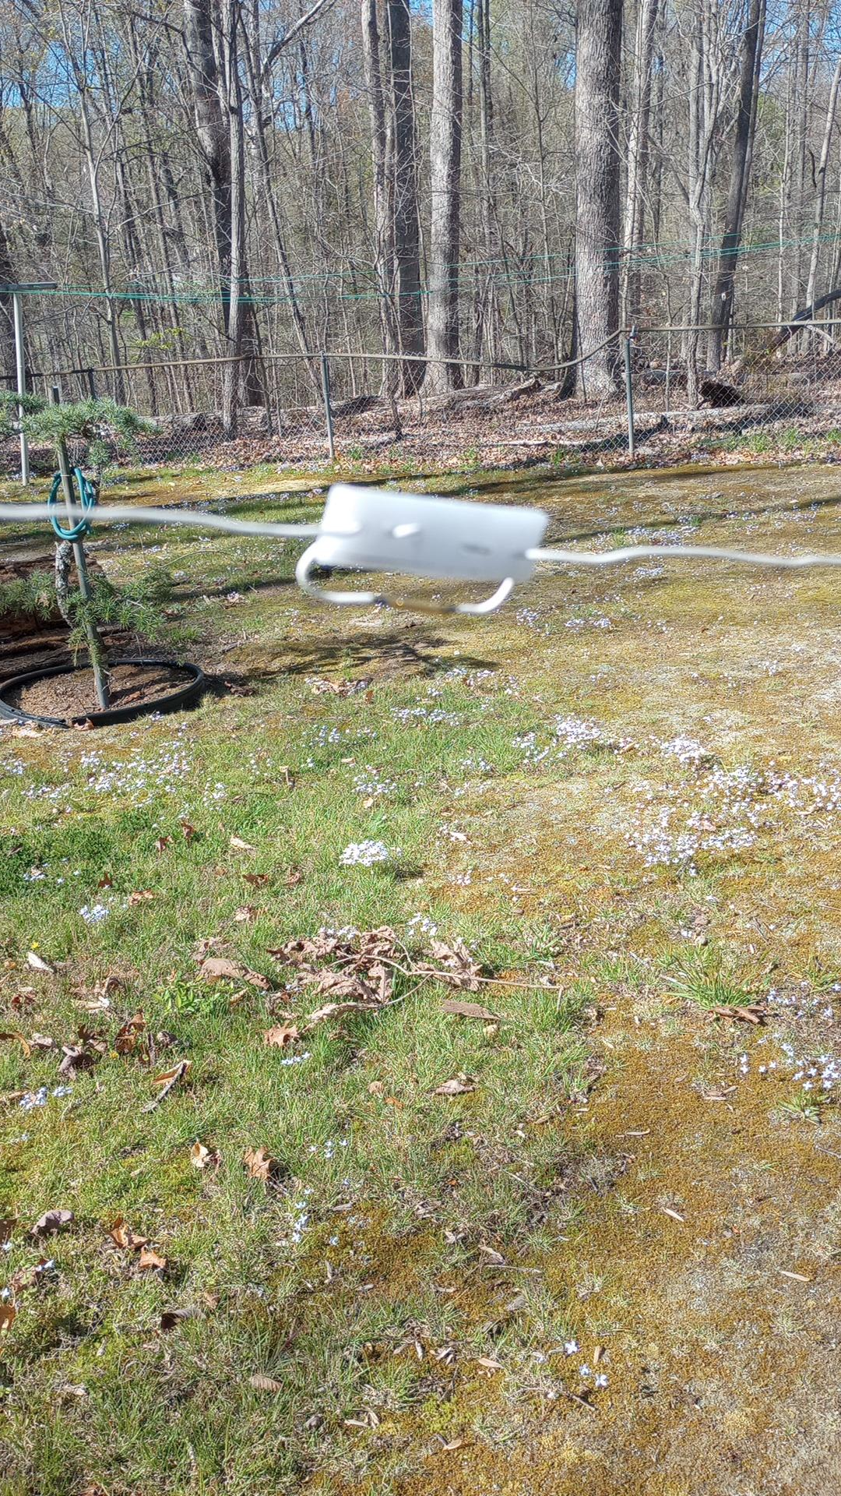

Slide 9
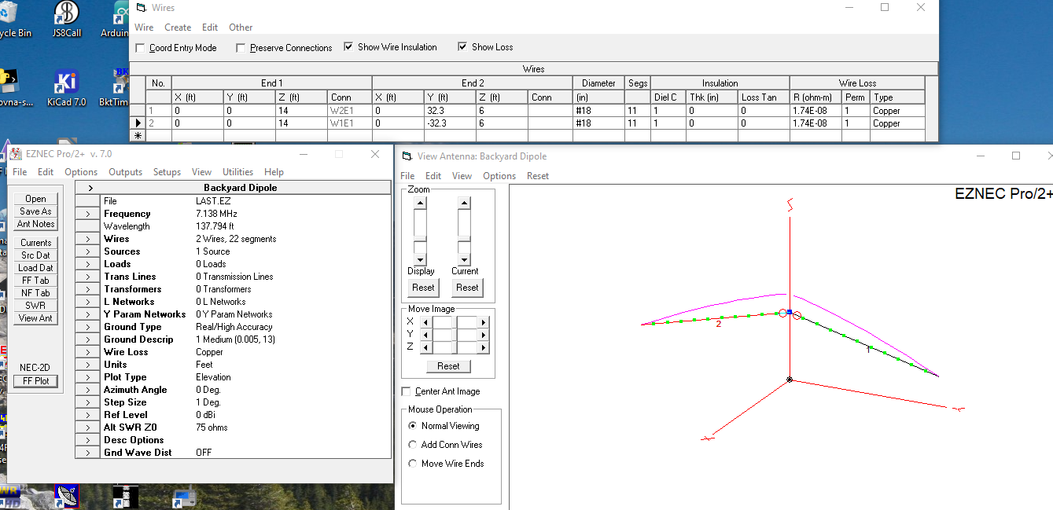

Slide 10
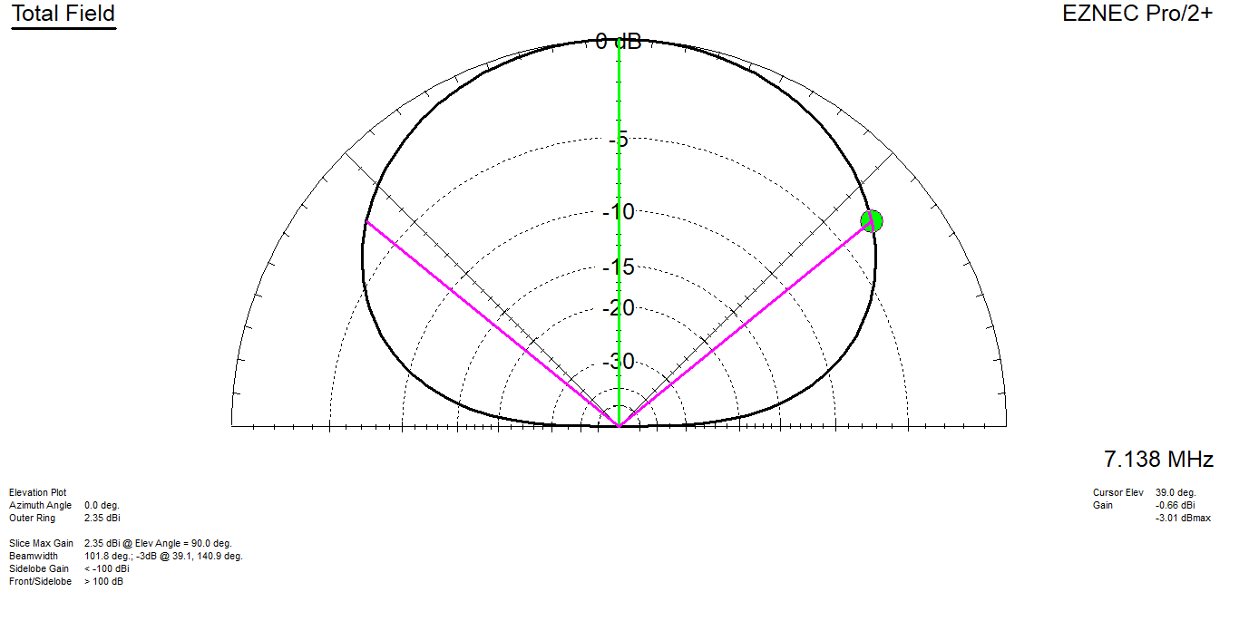

Slide 11
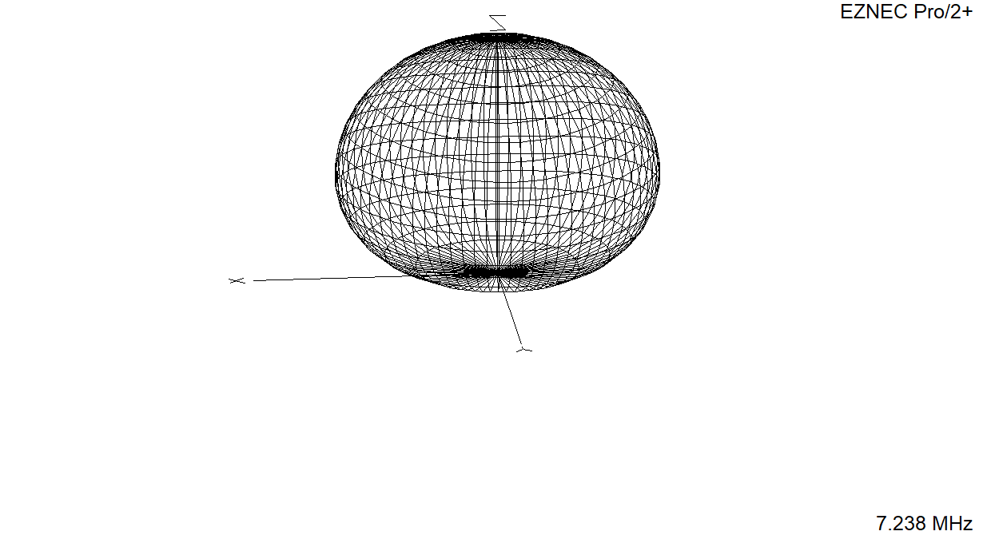
The ARRL Antenna Book, 22nd Edition
(Newington CT, ARRL 2011)

Slide 12
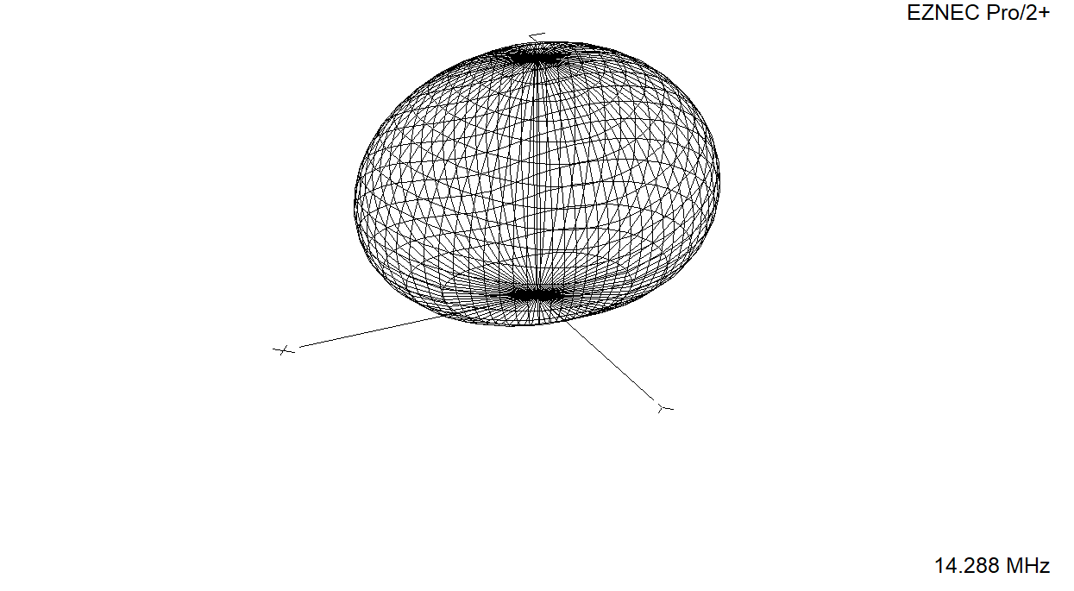

Slide 13
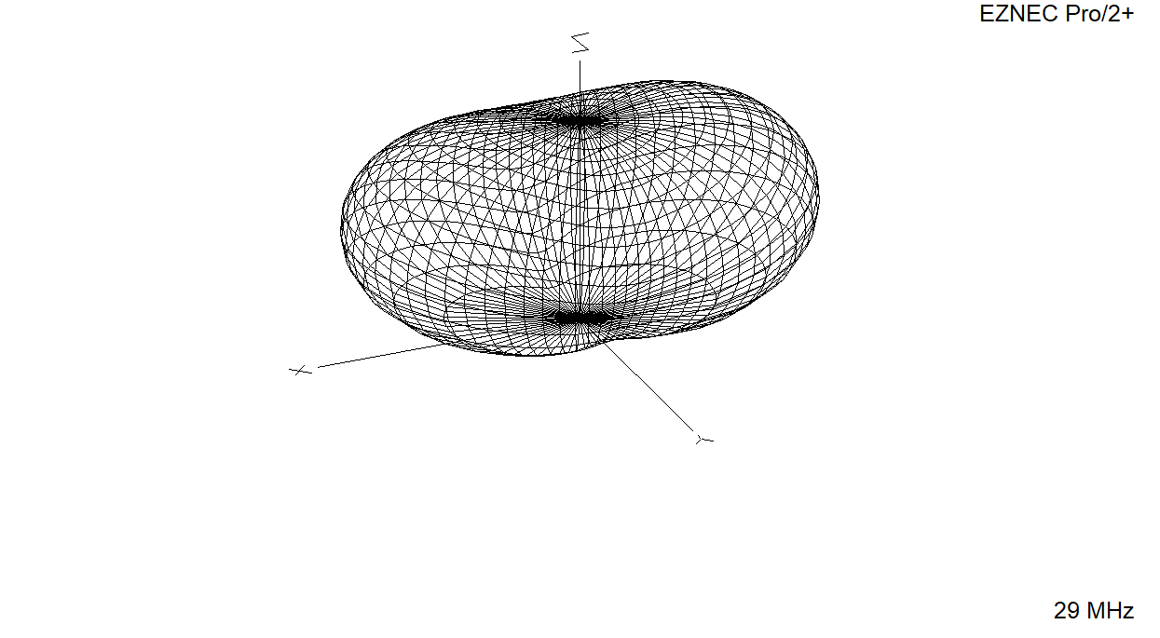

Slide 14
1
½ wave above ground – not inverted v

Slide 15
Backup Slides

Slide 16
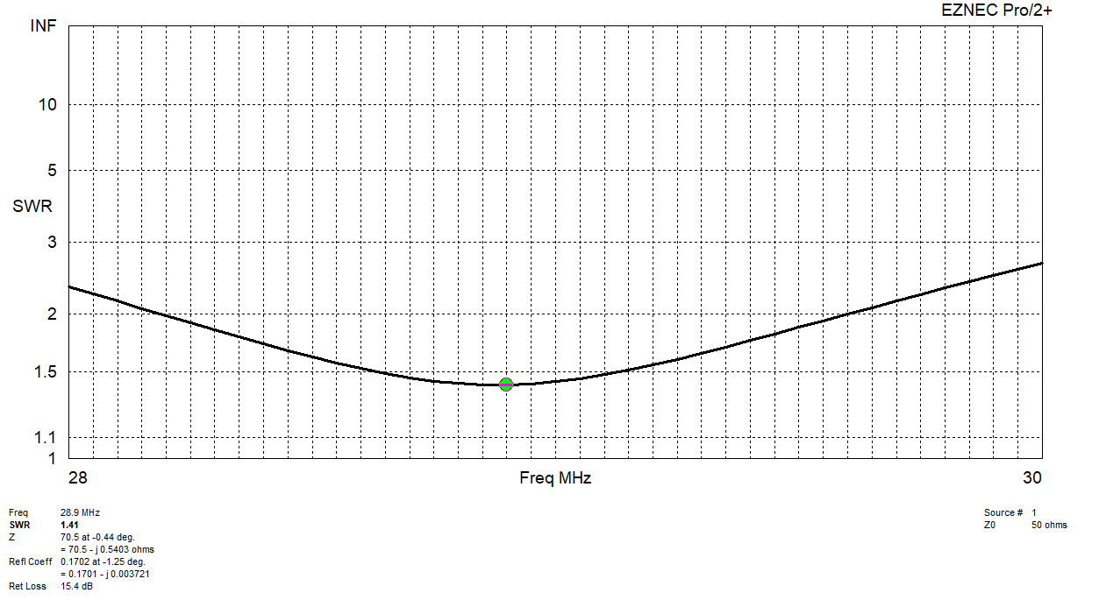

Slide 17
